Slide 1
Curriculum Information meeting
K Brown
July 2025

Slide 2
How the curriculum is being structured across the two-year groups
The curriculum will be on a two year rolling programme with a clear and balanced approach to planning for progression and continuity
The current Year 1/2 class have mainly followed the year 2 curriculum this year. Going forward they will mainly follow the year 3 curriculum (except for English and maths)which are taught according to individual year group expectations.
There will be end points for each year group covering objectives/skills as outlined by the national curriculum.
Differentiated planning to show clear objectives for each year group.
Mixed whole-class and group teaching
Any gaps in knowledge for the year 2 children will be addressed within the taught curriculum

Slide 3
English
All children will study the same core text but grammar, punctuation, and composition tasks will be differentiated according to Year 2 or Year 3 expectations.
The Red Prince - Purpose - to retell a story
Week one read story - immerse children in the text - predict /infer/ develop language of story – role play
Week 2 Develop skills (grammar/punctuation/sentence structure
Year 2 start to look at expanded noun phrases and sentence types
Year 3 will revise year 2 content but introduce new learning e.g Inverted commas
Week 3 - writing week – use skills, vocabulary and understanding of the text to retell the story at their level

Slide 4
English
📚 Reading
Both year groups will continue with guided reading sessions using phonic/fluency appropriate texts. Children will be grouped in own year group across the classes.
📖 Phonics & Spelling
Year 2: Will continue with Little Wandle Phonics.
Year 3: Will follow the Read Write Inc. Spelling programme. These will be taught separately.

Slide 5
Maths in a Mixed Year 2/3 Class
Topics will be taught across both groups, but with clear age-related expectations
Both year groups are taught explicitly and supported with group tasks, practical resources, and scaffolded work
Practical, hands-on learning (manipulatives, visual models, real-life contexts) ensures deeper understanding for all.
Challenge tasks are built in to stretch learners as well as targeted support and visual aids for those needing more help.
Regular assessment informs planning to keep children appropriately challenged and supported.
All children access the learning at their level, with challenge, support, and progression built in.
Goal: To develop mathematical fluency, reasoning, and confidence—for every learner, at every stage

Slide 6
: How Differentiation Works in Practice
Maths – Learning Objective: Addition and Subtraction Strategies
Introduce addition strategies using visual aids (number lines, part-part-whole models).
Year 2 focus:
Adding and subtracting two-digit numbers using number bonds and concrete resources.
Using tens and ones to understand place value.
E.g., 23 + 15 using cubes and counting on.
Year 3 focus:
Using formal written methods (column addition/subtraction).
E.g., 243 + 159 using column method and checking with inverse.

Slide 7
Curriculum Progression
The children will be taught using the school’s subject progression of skills and the NC. year group expectations/objectives.
Planning is carefully mapped to ensure no objectives are missed across the year.
Our medium-term planning shows clear links with prior learning and the new knowledge as well as key vocabulary children are expected to know
On going formative assessment allows us to monitor progress closely and adapt teaching accordingly, ensuring every child moves forward confidently.
As with any lesson differentiation will be planned for those children that need more support and those that need challenge.

Slide 8
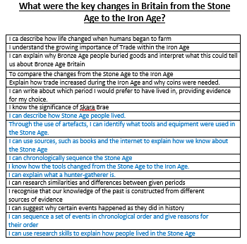

Slide 9
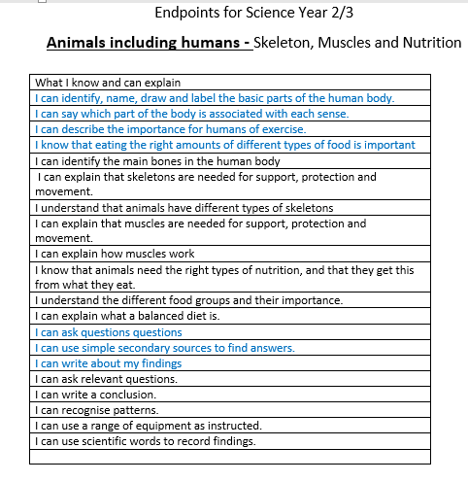

Slide 10
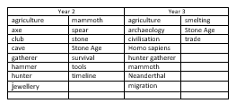
Vocabulary

Slide 11
Curriculum/routine changes
Year 3 children will have French during the KS1 collective worship. in upstairs classrooms
Year 3 children will be attending KS2 collective worships and spending playtimes etc in the KS2 playground.
Likewise the year 2 children will go to KS1 collective worship and playgrounds.

Slide 12
How assessment will work effectively in a mixed-year setting
Children will be assessed on their reading skills, writing and maths knowledge.
We have identified key learning that will be assessed at the end of a unit of work – End points.
The end points for science, history and geography will be assessed through ongoing work, short quizzes (linked to knowledge organiser info) and written explanations.

Slide 13
Will my child be held back if she/he is placed in a mixed age class?
Definitely not! The ways in which learning and teaching are organised means that teaching and work is tailored to the needs and current achievement levels of individual pupils.
The Staff are very experienced at planning and delivering work to match the needs of their class.
They provide challenge for the more able children and support for those needing more help whichever year group they are currently in.
The school will plan the educational experiences for pupils in all classes in ways which ensure good progression and continuity, which ever year group or class they are in.

Slide 14
Benefits of a Mixed-Age Class
Peer mentoring and modelling– older children reinforce learning by helping younger peers
Encourages responsibility and independence - builds confidence
Promotes leadership empathy and collaboration
Flexible groupings to meet individual needs
Nurtures a family-style classroom
Younger children are inspired by older role models

Slide 15
Confidence and Independence in Year 2 Students
Opportunities for Year 2 students to engage in collaborative tasks with Year 3 peers can significantly boost their confidence and independence regarding problem-solving situations.
As they participate actively in group projects, they learn to express their ideas and take ownership of their contributions.
This active participation nurtures resilience and prepares young learners to tackle future challenges with greater assurance, creating a proactive attitude towards learning and personal growth.

Slide 16
Leadership Development in
Year 3 Students
For Year 3 students, mixed-age classrooms provide a valuable opportunity to enhance their leadership skills. By helping Year 2 classmates, they not only learn to assume responsibility but also develop a sense of pride in their role as mentors.
Assisting younger peers reinforces their own learning as they explain concepts during collaborative projects. Furthermore, this experience fosters maturity and the ability to relate to various age groups, preparing them for future academic and social environments.

Slide 17
Research based benefits to mixed-aged classes
A research study found that there is no empirical evidence that student learning suffered in any way in mixed age classrooms.
Children in such classrooms did not learn more or less than students in single age classes.
In fact, students in multi age classes scored higher on attitudes towards school, personal adjustment and self-concept than students in single age classes.
Various studies have shown that students in mixed-age classrooms often demonstrate higher levels of academic achievement compared to those in traditional year-specific classes. The integration of different age groups promotes a motivating learning environment; when students see their peers engaged and excited about their education, it fosters a culture of enthusiasm and curiosity. This diverse classroom dynamic encourages all children to strive for excellence and contributes significantly to their overall academic success.

