Slide 1
Curriculum Information meeting
K Brown
July 2025

Slide 2
How the curriculum is being structured
The KS1 curriculum is a two year programme with a clear and balanced approach to planning for progression and continuity
The Reception/year 1 mixed class will mainly follow the year 1 curriculum topics with adaptations made for Reception. We will still ensure the Reception class have the freedom for staff to go with the children’s interests.
There will be separate planning for Reception and Year 1 showing objectives covered
There will be end points for each year group covering objectives/skills/knowledge as outlined by the national curriculum/EYFS Early learning goals.

Slide 3
English
The Year 1 children will study a core text with written tasks based on it. For Reception the book will initially be done through carpet time discussions and enhancements in the areas – eg book making, lists and letter writing.
Funny Bones - Purpose - to retell a story
Week one – reading week - read story - immerse children in the text - predict /infer/ develop language of story – role play
Week 2 - skills week - develop skills (grammar/punctuation/sentence structure
Week 3 - writing week – use skills, vocabulary and understanding of the text to retell the story at their level

Slide 4
English
📚 Reading
Both year groups will have 3 guided reading sessions a week using the Little Wandle phonic texts. Children will be grouped in own year group across the classes.
📖 Phonics
Phonics will be taught separately - at different times of the day.
Reception cover phase 2, 3 and 4 whilst Year 1 cover phase 5.

Slide 5
Maths
Maths will be taught separately - using the White Rose Scheme - with clear age-related expectations
Year 1 will have their input by the class teacher and then supported with their learning by the teacher/TA. This will be done in small groups(in the spare classroom for the mixed class)) to support the children to embed their understanding.
Practical, hands-on learning (manipulatives, visual models, real-life contexts) ensures deeper understanding for all.
Challenge tasks are built in to stretch learners as well as targeted support for those needing more help
Regular assessment informs planning to keep children appropriately challenged and supported.
Reception children will have their daily maths input after snack time – whilst the Year 1 children are having their break in the KS1 playground. Activities for Reception will be set up as part of provision.

Slide 6
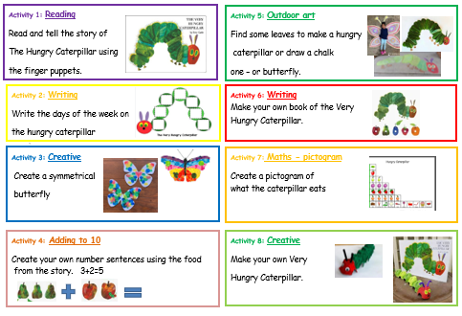
Provision
Both classes will have provision activities that the children access independently – as in Reception.
For Year 1 there are the direct teaching activities. Provision will continue with passport activities alongside the children’s own play based learning.

Slide 7
Wonderful Me!
Much of our learning is done through a theme. This will be taught to the class with age appropriate objectives and specific activities planned for.
Reception
Year 1
Drawing themselves and their family
Explore the different areas of the classroom
Hospital role play
People who help us
Make books using pictures about the body
Draw a skeleton
Identify, name, draw and label the basic parts of the human body and say which part of the body is associated with each sense. (Science)
Create a family tree
Find out about Mary Seacole & Florence Nightingale (History)
Obserational drawing - portraits – Picasso faces (Art)
Make a skeleton - DT
Notes:
Observational drawing

Slide 8
Year 1 combined sessions.
There will be opportunities for the year 1 children to be taught in two year 1 groups where they will be taught the R.E, Music and PSHE curriculum.
There will be another opportunity when Year 1 have a computer lesson and another PE session.
At break time all Year 1 children will play on the KS1 playground.
Year 1 children will eat their lunches together as a year group and return to the KS1 playground for the remainder of their lunchtime.
Year 1 children will take part in the KS1 Sports Day.
Year 1 will join whole school Collective Worship on Mondays and Thursdays

Slide 9
How have the classes be classes be allocated?
Careful consideration was given by the staff who teach and know the current Reception children on who is best suited to each class.
The range of factors being taken into account, included:
Friendship groups
Gender
Emotional development,
Readiness to learn
Any additional needs.
We always consider what is best for each child individually in these decisions.

Slide 10
Will my child be held back if she/he is placed in a mixed age class?
Definitely not! The ways in which learning and teaching are organised means that teaching and work is tailored to the needs and current achievement levels of individual pupils.
The Staff are very experienced at planning and delivering work to match the needs of their class.
They provide challenge for the more able children and support for those needing more help whichever year group they are currently in.
The school will plan the educational experiences for pupils in all classes in ways which ensure good progression and continuity, which ever year group or class they are in.

Slide 11
Benefits of a Mixed-Age Class
Peer mentoring and modelling– older children reinforce learning by helping younger peers
Encourages responsibility and independence - builds confidence
Promotes leadership empathy and collaboration
Flexible groupings to meet individual needs
Nurtures a family-style classroom
Younger children are inspired by older role models

