Slide 1
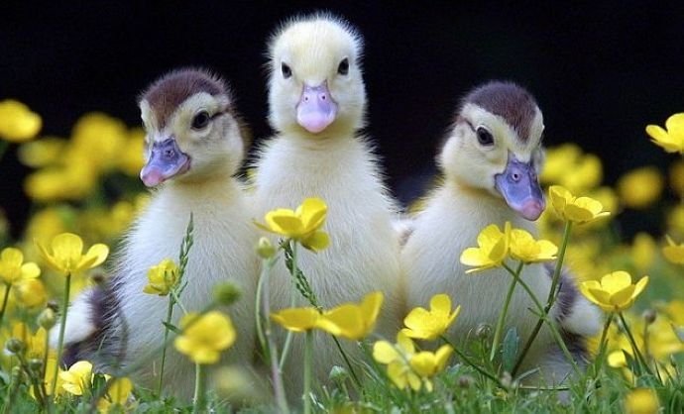
Hello everyone in KS1

Slide 2
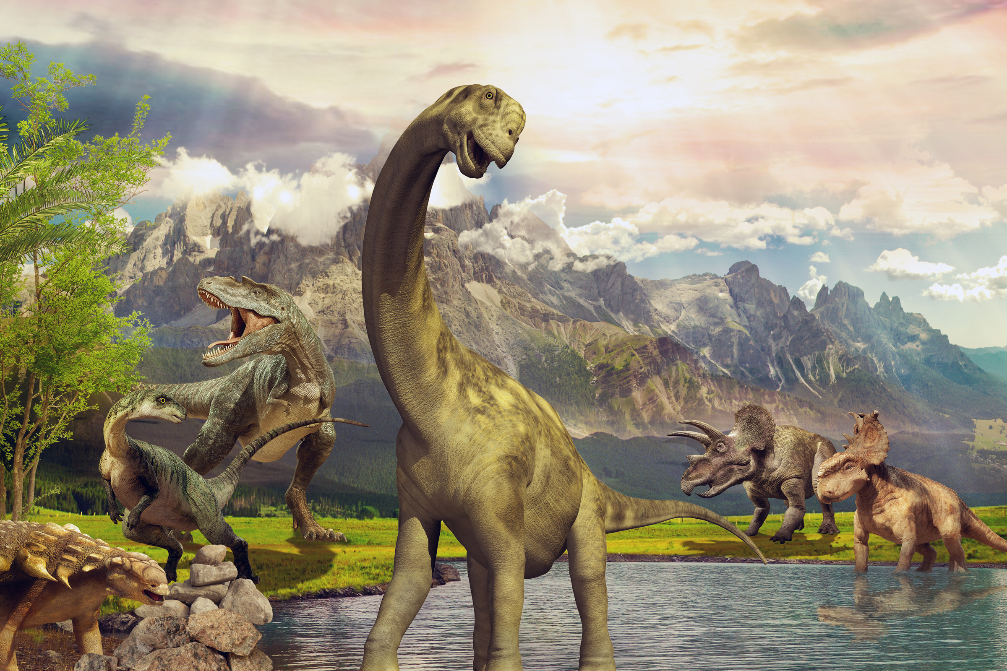
Creating a timeline

Slide 4
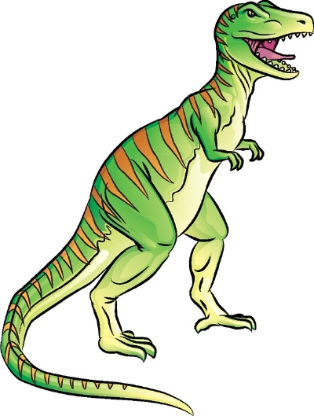
Drawing dinosaurs

Slide 5
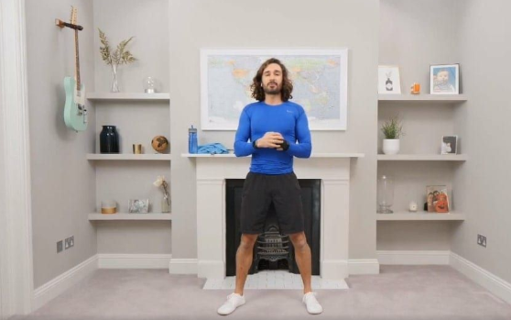
Fitness and health

